Slide 1
Spares New Buy Process
ESCM Mesa
BOEING PROPRIETARY

Slide 2
Spares New Buy Process
Buys performed on a Monthly Cycle (SPO)
Complete Service, Planning & Optimization (SPO) monthly update (SPO)
Evaluate SPO Tactical Recommendations (SPO)
Export SPO tactical recommendations (SPO)
Supplier Long Term Agreement (LTA) visibility/evaluation (NB)
Capture Asset manager decisions and rationale (NB)
Combined Program review boards approves asset manager recommendations (NB)
GOLD cap orders created automatically upon approval decision in tool (NB)
GOLD cap order pushed to MS2 and on to supply source (Braids/Compass or NWP for direct ship) (GOLD)
BOEING PROPRIETARY

Slide 3
Spares New Buy Process
SPO/Asset manager sync Check
Report generated from New Buy Tool that captures all recommendations vs Asset manager actions
Analysis performed on significant differences
Forecaster/Asset manager meeting to discuss differences, generate action items, etc.
BOEING PROPRIETARY

Slide 4
ESCM New Buy Tool - Overview
Allows Asset Managers to provide input, perform validation, and disposition SPO recommended buys. Allows loading of finalized orders to GOLD en masse. Provides report results to program management.
Business Value: Enhances support personnel ability by making it easier to translate recommended buys into actual, cost-effective orders. Provides a platform to deliver related information to enable decision making (LTA), reduces order delay with automated system validation, captures decision metrics for continual model/process improvement. 8 Apache Programs - US Government, Netherlands, Saudi Arabia, United Arab Emirates(UAE), Taiwan, Kuwait, United Kingdom (UK) and Corpus Christi Army Depot (CCAD).
Users: 35 - Mesa (25), Philadelphia(5), CCAD(4) and UK(1)
Technology: Oracle stored procedures, .NET Web Application
BOEING PROPRIETARY

Slide 5
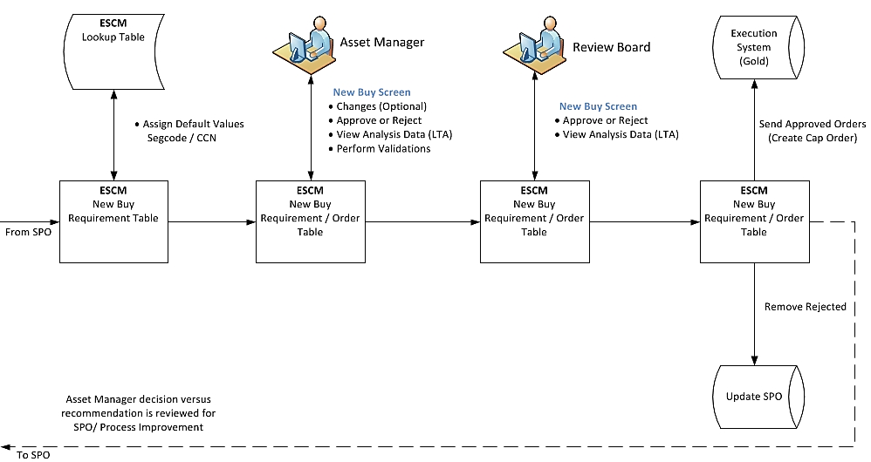
ESCM New Buy Tool - Workflow
BOEING PROPRIETARY

Slide 6
ESCM New Buy Tool - Function
New buy Import
Exported orders automatically imported into new buy tool every 5 minutes
Segcode, CCN and other data defaults added
Default Order created to satisfy import recommendation
Asset Manager – Requirement
View, Sort, Group imported recommendations for all assigned parts across all Apache CLS programs
Identify any common recommendations for multiple programs
BOEING PROPRIETARY

Slide 7
ESCM New Buy Tool - Function
Asset Manager – Order
Accept, Reject or modify associated order(s) for 1 or selected recommendations
Split order according to desired date and quantity
View associated analysis data: total next year forecast, current production PR/PLO, LTA price break
Capture asset manager comment and decision feedback
Review Board
Review approved orders
Approve or Reject for order placement
CAP Order Creation
Create and place GOLD cap order automatically every hour
Remove rejected exported recommendations from SPO
BOEING PROPRIETARY

Slide 8
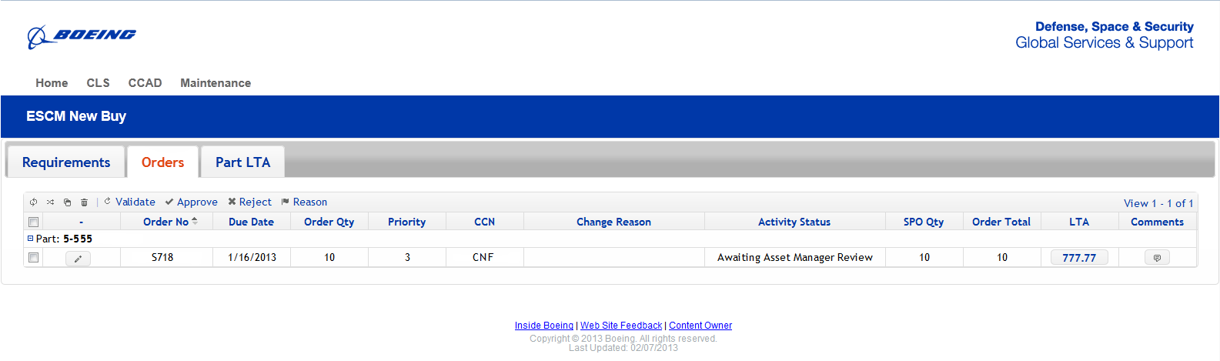
BOEING PROPRIETARY

Slide 9
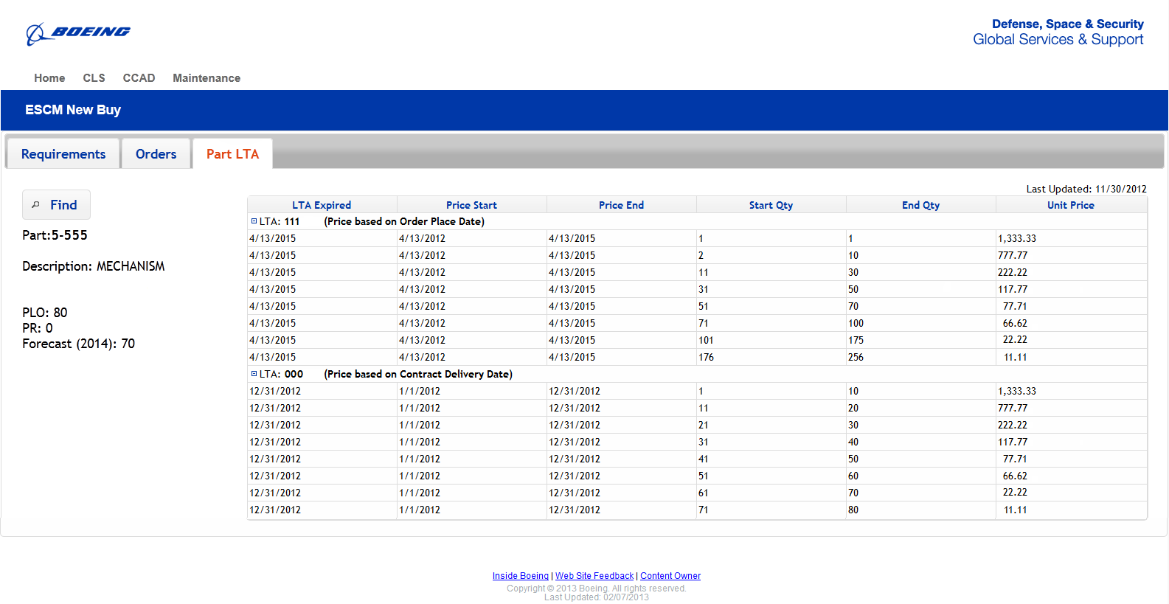
BOEING PROPRIETARY

